Slide 1

Iris Flower Species Identification Using KNN and Map Reduce on Hadoop
Guided by:
Pradeepa S
School of Computing
AP-III
Done by:
M. Sree Charan
121003168
CSE

Slide 2

Base Paper
Author: Jesus Maillo, Isaac Triguero, Francisco Herrera
Title: A MapReduce-based k-Nearest Neighbor Approach for
Big Data Classification
3) Year of publication: 2015
DOI: 10.1109/Trustcom.2015.577
5) Published in: IEEE.
/60

Slide 3
Problem Statement
Abstract:
This model allows us to simultaneously classify large amounts of unseen cases (test examples) against a big (training) dataset. To do so, the map phase will determine the k-nearest neighbors in different splits of the data. Afterwards, the reduce stage will compute the definitive neighbors from the list obtained in the map phase.
The implementation of the model includes six basic steps of machine learning that are:
1. Collect data/prepare data
2. Choose algorithm (KNN)
3. Creating object of the model
4. Train the model by training dataset
5 .Making prediction on unseen data or testing data
6. Evaluation of the model
/60

Slide 4
DATASET
Dataset information: The Iris dataset was used in R.A. Fisher's classic 1936 paper, The Use of
Multiple Measurements in Taxonomic Problems, and can also be found on
the UCI Machine Learning Repository.
Number of Coumns: 5
Nuber of Rows : 150
Dataset link: https://www.kaggle.com/uciml/iris?select=Iris.csv
Column 1: Sepal Length(in cms)
Column 2: Sepal Width(in cms)
Column 3: Petal Length(in cms)
Column 4: Petal Width(in cms)
Column 5: Species name
/60

Slide 5
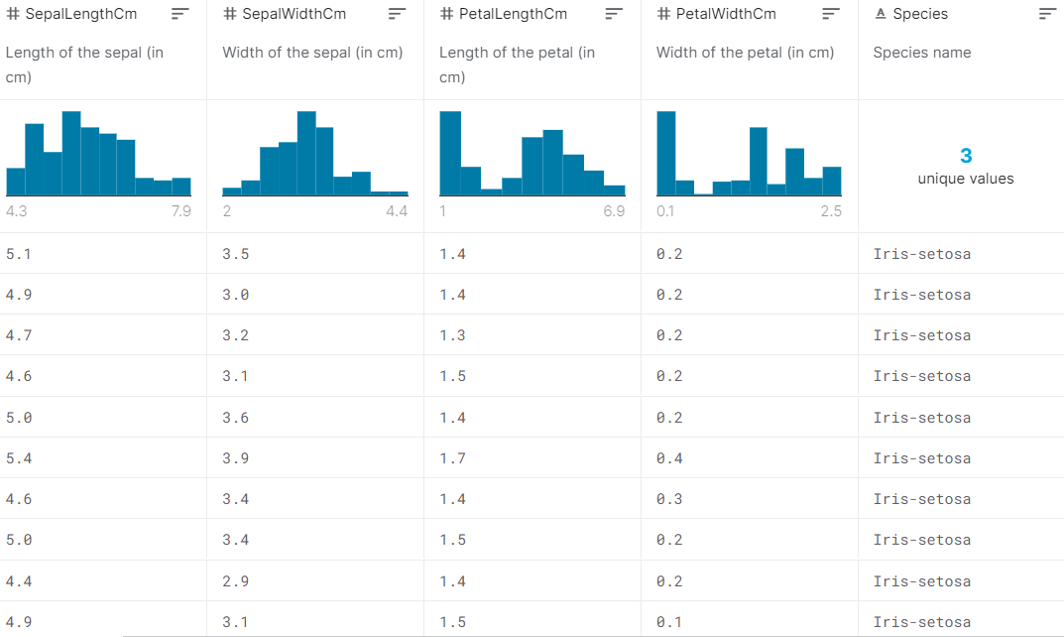
DATASET VISUALISATION
/60

Slide 6
Implementation
Aim: K Nearest Neighbour implementation using Hadoop 1.2.1
Execution : hadoop jar knn.jar knn /datafolder/input.txt /datafolder/train.txt /tmp/result/
KNN Algorithm :
Calculate the distance between the input data point and the points given in the training set.
Sort the distance vector and select top 'k' points which are nearest (least distance) to the input point.
Output the majority among the class labels of 'k' points selected in step b.
MapReduce Procedure :
Distance of the points and 'k' nearest points are selected and the distance along with class labels are sent to the reduce part.
Further the output is predicted based on the majority in the input of the reduce part.
/60

Slide 7
Thank You
/60

